Slide 1
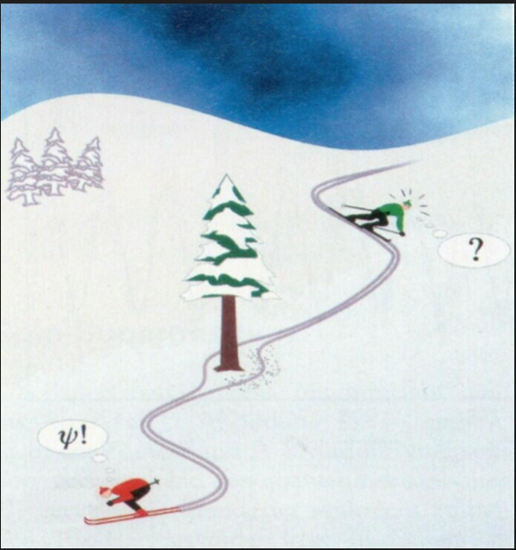
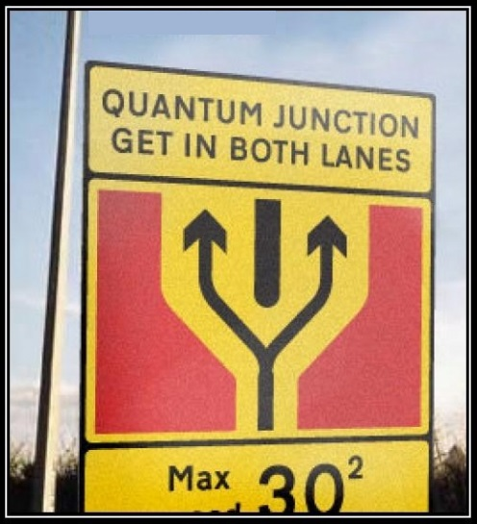

Slide 2
measurement
QUBIT
MEASUREMENT = reading of the information through a special equipment to determine the status of the system
State of bit before the measurement | result of measurement | State of bit after the measurement
0 | 0 | 0
1 | 1 | 1
classic case: the measure is deterministic and does not alter the state of the bit
Probabilistic and destructive
Quantum measurement
State of bit before the measurement | result of measurement | State of bit after the measurement
$\left.|Q\right\rangle =a\left.|0\right\rangle +b\left.|1\right\rangle$ | 0 with probability $p_{0}={|a|}^{2}$ 1 with probability$p_{1}={|b|}^{2}$ | $$\left.|0\right\rangle$$ $$\left.|1\right\rangle$$
Note: it explain the condition ${|a|}^{2}{+|b|}^{2}=1$; the sum of probability must be 1-

Slide 3
superposition principle
2 QUBIT
COMPOUND SYSTEM
bit 1/bit2 | 0 | 1
0 | 00 | 01
1 | 10 | 11
2 bit: 4 alternatives
2 qubit: 4 states corresponding to the classic one + superposition principle
2 qubit
$$\left.|Q_{1}Q_{2}\right\rangle =a\left.|00\right\rangle +b\left.|01\right\rangle +c\left.|10\right\rangle +d\left.|11\right\rangle$$
With $a, b, c, d$complex number and ${|a|}^{2}{+|b|}^{2}{+|c|}^{2}{+|d|}^{2}=1$

Slide 4
logic gates
2 QUBIT
2 qubit logic gate
$$\left.|Q_{1}Q_{2}\right\rangle =a\left.|00\right\rangle +b\left.|01\right\rangle +c\left.|10\right\rangle +d\left.|11\right\rangle$$
$$\left.|Q_{1}′Q_{2}′\right\rangle =a′\left.|00\right\rangle +b′\left.|01\right\rangle +c′\left.|10\right\rangle +d′\left.|11\right\rangle$$
With $a’, b’, c’, d’$ linear combination of $a, b, c, d$
G

Slide 5
measurement
2 QUBIT
Measurement
a measure on the qubit $Q_{1}$ allows us to determine if the first qubit is in $\left.|0\right\rangle$or $\left.|1\right\rangle$ (similarly for $Q_{2}$ ), this measure is probabilistic and destructive
Examples. $\left.|Q_{1}Q_{2}\right\rangle =a\left.|00\right\rangle +b\left.|01\right\rangle +c\left.|10\right\rangle +d\left.|11\right\rangle$

Slide 6
entanglement
2 QUBIT
$a=b=1/{\sqrt{2}} , c=d=0$ – produced state
State of bit before the measurement | State of bit after the measurement | result of measurement on $Q_{1}$ | result of measurement on $Q_{2}$ | $$Q_{1}=Q_{2}$$
$$\left.|Q_{1}Q_{2}\right\rangle =a\left.|00\right\rangle +b\left.|01\right\rangle$$ | $\left.|00\right\rangle$ with probability${|a|}^{2}=1/2$ $\left.|01\right\rangle$ with probability${|b|}^{2}=1/2$ | 0 0 | 0 1 | YES NO
no correlation between $Q_{1}$ and $Q_{2}$
$a=d=1/{\sqrt{2}} , b=c=0$ – entangled state
State of bit before the measurement | State of bit after the measurement | result of measurement on $Q_{1}$ | result of measurement on $Q_{2}$ | $$Q_{1}=Q_{2}$$
$$\left.|Q_{1}Q_{2}\right\rangle =a\left.|00\right\rangle +d\left.|11\right\rangle$$ | $\left.|00\right\rangle$ with probability${|a|}^{2}=1/2$ $\left.|11\right\rangle$ with probability${|b|}^{2}=1/2$ | 0 1 | 0 1 | YES YES
Both the measurement on $Q_{1}$ and $Q_{2}$ is unpredictable
perfect correlation between $Q_{1}$ and $Q_{2}$
When it happens, the two qubit are entangled

Slide 7
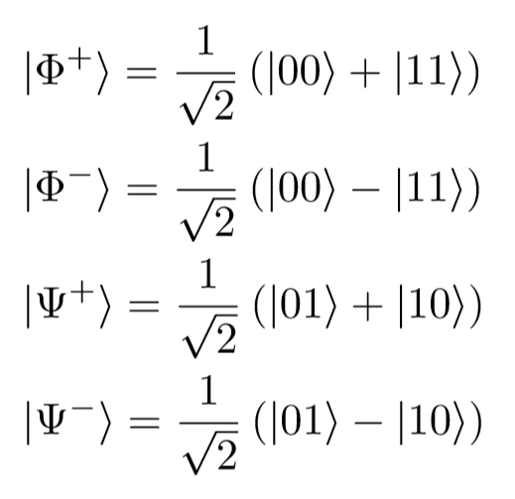
Bell States
2 QUBIT
Bell States
(maximally entangled)

Slide 8
circuit
2 QUBIT
How to create entangled states
Exercise: what is the exit states if $\left.|Q_{1}Q_{2}\right\rangle =\left.|01\right\rangle ,\left.|10\right\rangle , \left.|11\right\rangle$?

